Slide 1
Firewalls
INFSCI 1075: Network Security – Spring 2013
Amir Masoumzadeh

Slide 2
Outline
Firewalls
  Design goals
  Advantages and disadvantages
  Services
Classification of firewalls
  Static Packet Filtering
  Stateful
  Proxy
Firewall architectures

Slide 3
Protection and Prevention Mechanisms
How do attacks succeed?
  Oscar gets information (reconnaissance)
  Oscar exploits vulnerabilities
    Common weaknesses in design and bugs in software services
Protection and prevention
  Stop (or block) packets that are sent with the purpose of reconnaissance or exploitation
  Authenticate and encrypt communications to prevent Oscar from obtaining information or being able to communicate

Slide 4
Firewalls
Protect buildings that were susceptible to fire
  People built thick walls made of brick between such buildings
  If a building caught fire, the thick wall would prevent it from spreading to surrounding buildings
  Damages would be minimized
The “Internet Firewall” prevents security attacks from spreading into the intranet or private network of an organization

Slide 5

What is a Firewall?
A network level access control mechanism
  In broad terms a firewall is all of the following
  A collection of hardware and software PLUS a security policy
  Something placed between a corporate intranet and the Internet
    Seeks to prevent unauthorized and unwanted communications into or out of the corporate intranet
  Allows the organization to implement and enforce its own traffic flow policy between the Internet and the Intranet
Today it means many things
  Ranges from a simple packet filter to a complex intrusion prevention system
  These days you have “host firewalls” that prevent a host machine from picking up some types of packets
“Outside”
“Inside”
Public
Private

Slide 6
Design Goals
All traffic from inside the private network to outside and vice-versa MUST pass through the firewall
Only authorized traffic defined by a local “security policy” will be allowed to pass
The Firewall is as tamperproof as possible
  Fewer bugs, vulnerabilities, and security loopholes
    Host security does not scale well comparing to a firewall in the network
      Multiple Operating Systems
      Complex access controls
      Vulnerabilities in new software
      Difficult to audit
  Runs less software than most hosts and is much more controlled

Slide 7
Advantages and Disadvantages
There is only one host/machine/device to be protected - the firewall
  Simplifies security management
  Possible to implement advanced logging and monitoring
  Can create a VPN using IPSec to other hosts
  Enables segmentation and isolation of problems
  Hides the IP addresses of client stations in an internal network by presenting one IP address to the outside world
Disadvantages
  Bottleneck
  Single point of failure
  False aura of confidence

Slide 8
Services Provided by a Firewall
Service control
  Determines the types of services that can be allowed inbound or outbound
Direction control
  Determines the direction in which a service may be initiated and allowed to flow
User control
  Determines access to a service depending on which user is attempting to access it (both inbound and outbound)
Behavior Control
  Controls how some services are employed
    e.g., DNS, filtering e-mail, etc.

Slide 9
Protection with Firewalls
Protects against
  Information theft (Reconnaissance)
    e.g., prevents requests to and responses from services within the private network reaching the outside
  Information sabotage (Exploitation/Pillage)
    e.g., prevents uploading derogatory content onto a company’s web page or changing an employee’s medical records, etc.
  Denial of Service (Pillage)
    e.g., prevents common DoS attacks like Smurf on internal hosts

Slide 10
Additional features in firewalls
Demilitarized zone firewalls (DMZ firewalls)
  A region of the network is protected, but accessible to outsiders
  The rest of the network is NOT accessible
Content filtering
  Ensure that employees do not access particular content like stock quotes
  Can define categories of unwelcome material
  Can block certain web-sites
Anti-virus protection
  Can assist with virus detection
VPNs

Slide 11
Limitations of Firewalls
Cannot protect against
  Attacks that bypass it
    Physical removal of files
    Dial-up modems from hosts on the Intranet
    Gullible employees
  Internal threats and insider attacks
    Malicious employees
  Viruses in general
    Viruses may come in to the network in several ways
Firewalls are not foolproof
  They will allow what you permit them to allow
  Human errors can lead to security breach

Slide 12
Firewall Topics
Types of firewalls
  Packet Filters, Stateful Firewalls, Proxy Firewalls
    Performance – Security tradeoffs
Firewall policies
  Implementation and pitfalls
Firewall architectures
  Where do you place firewalls?
  What functions will they perform?
  How do you isolate different segments of your private network?

Slide 13
Types of Firewalls (Based on Functionality)
Types of
Firewalls
Packet Filters
Proxy
Firewalls
Static or Stateless
Packet Filters
Dynamic or Stateful
Packet Filters
(Stateful Packet
Inspection)
Circuit Level
Gateways
Application
Level
Gateways

Slide 14
Packet Filters vs. Proxies
Packet filters examine packets entering a network one at a time
  Examination of packets involves rules set by an administrator
  Packets can be blocked to certain hosts or services (IP addresses and ports)
  Packets can be blocked if they correspond to certain protocols
Proxies
  Reproduce application layer functionality
  Isolate the protected network from the rest of the world
  Packets are not examined one-by-one but are completely decoded
    Examination after decoding reveals if it is a valid request

Slide 15
Some Remarks – I
The “type” of firewall depends on how high in the protocol stack a “packet” is examined
  The higher the layer of examination, the worse the performance
    Requires more processing and slows down packet flow
  The higher the layer of examination, the more secure the network is
    Obtains more information about what a packet is trying to do before allowing it or dropping it
Improvements in technology have reduced the degradation in performance, but it is still a factor

Slide 16
Some Remarks – II
Classification of firewalls is a useful exercise, but actual products may do many things
Most firewalls have overlapping functions
  May do some static and some dynamic filtering
  May also look at the payload of certain applications but may or may not act as a proxy
  May have both software and hardware components
Policies of firewalls can also fall into overlapping categories

Slide 17
Static Packet Filters
A type of firewall that blocks or allows a packet based TCP/IP headers
  Stateless
    Operates on each packet individually
  Oldest type of firewall
Whether a packet is allowed or not depends on
  A set of rules encoded in the software running the packet filter
  Parses the IP header and TCP/UDP segment header and checks for
    Protocol numbers, source and destination IP addresses, TCP port numbers, TCP connection flags, ICMP etc.
  Compares the information with the rules in sequential order till the packet matches a particular rule
    If no rule matches the packet, a default action is taken

Slide 18
Operation of Static Packet Filters
When you filter packets, what is outside and what is inside can get fuzzy depending on the interface
Need to exercise great care in setting rules as we will see next
TCP/UDP
Examine Packet
NETWORK
LINK
Packet from
“outside”
Packet allowed
“inside”
PHYSICAL

Slide 19
In and Out…
Packets coming “in” to one interface may be going “out” of another interface
Many access control lists are based on filtering packets coming “in” or going “out” of an interface
Best to filter packets as they come in to avoid additional processing
“Outside”
“Inside”
in
in
Public
i1
i2
Private
out
out

Slide 20
Packet Filtering
Can be done based on
    Source address
    Port number and Destination address
    Combination of both

Slide 21
Source Address Filtering
There are some common terms used to indicate packet filtering by source address
Friendly Net
  Allow some IP addresses that are from known networks
  Not advisable to use this approach - why?
Ingress filtering
  Refers to filtering at the interface that allows packets from outside to come into the internal network
Egress filtering
  Refers to filtering at the interface that accepts packets leaving the internal network
  Block addresses that do not belong to the internal network (why?)
  Block addresses that are NOT supposed to connect to the Internet
  Log all rejected packets - why?

Slide 22
Some Common Rules –
Filtering by Source Address
Deny entry to IP packets with certain source addresses
  What addresses can we deny without fear of blocking legitimate traffic?
    RFC 1918 addresses - Block addresses such as 10.0.0.0 - 10.255.255.255, 172.16.0.0 - 172.31.255.255, 192.168.0.0 - 192.168.255.255
    Loopback address 127.0.0.1, multicast addresses 224.0.0.0 - 239.255.255.255
    Internal addresses
    Perhaps addresses originating from certain domains (.in, .ru, .cn)
Deny exit from network to IP addresses that are supposed to be used internally
Temporarily or otherwise block certain IP source addresses
  You can identify some IP addresses that are launching DoS attacks
  There are some IRC servers or certain websites that you don’t want your users to connect

Slide 23
Port Number and Destination Address Filtering
Allows access for
  Specific “channels” between networks
  Specific public services like DNS or web
  Specific packet types like ICMP MTU violations
Can filter packets based on port numbers, flags in headers, specific protocol types
  Additional granularity
  Slows filtering process compared to “source address only” filtering

Slide 24
Some Common Rules –
Filtering by Destination Address and Ports
Friendly Net
  It is possible to tighten up the friendly net rule by specifying certain port numbers and destination hosts only
  Example: Allow host 130.215.17.13 to access 136.142.117.13 if it has port number larger than 1023 and it is connecting to port number 80 only
  Still not recommended without authentication and architectural separation
Allowing and disallowing certain types of traffic
  You can block certain types of traffic leaving your network like IRC, Instant Messaging, Kazaa or ICMP
  Example: Block ICMP echo requests from any host to any host
    Is this a good idea? Where should an alternative be placed?

Slide 25
Alternatives for Blocking ICMP
Network you have reason to communicate with
  Permit ICMP echo request messages to leave your network destined for such a network
  Permit ICMP echo reply messages to your internal hosts from such a network
Server that must be accessible (public web servers, for example)
  Permit ICMP echo request messages from external hosts to such a server
  Permit ICMP echo reply messages from such a server to the networks where that server's users reside
Deny every other ICMP echo message

Slide 26
Rule Set Example
Identify protocol and what the rule may mean
Assume it is applied at the interface of a filter that accepts incoming packets to the network 136.142.117.X/24
Rule
Protocol
Source Address
Destination Address
SRC-Port
DEST-Port
Action
1
TCP
130.215.17.0/24
136.142.117.221
> 1023
22
Allow
2
TCP
Any
136.142.117.13
> 1023
80
Allow
3
TCP
136.142.117.0/24
Any
Any
Any
Block
4
UDP
Any
136.142.117.13
> 1023
53
Allow
5
UDP
Any
136.142.117.14
> 1023
53
Allow
6
Any
Any
Any
Any
Any
Block

Slide 27
Packet Filtering Rule Set - Rules of Thumb
Rules are matched based on all parts of the rule
    Allowing connections you need and denying the rest is usually better than specifically denying the stuff you suspect
Specific rules must precede general rules
    Otherwise packets may be admitted or denied by a general rule before it is tested for a specific rule
    Example: In the previous rule set, Rule 6 cannot be placed prior to any other rule
      What happens if it is placed first in the list?
Place the most active rules near the top
  Save processing
Adding rules in an ad hoc manner can result in catastrophes
    Great care must be exercised to ensure that rules do what they are supposed to do

Slide 28
Services to Filter
Web
  Allow outbound HTTP or HTTPS requests
  Use architectural methods to protect your network against inbound http requests (later)
FTP
  Tricky protocol - needs more attention than the rest
TCP
  Incoming TCP connections should not be allowed unless they were initiated from the inside
  Hard to do with simple packet filters!
SMTP/Mail
  Need to be checked to see if they are “valid”
  No viruses, spoofed addresses etc.
  Hard to do with packet filters!
POP3/IMAP
  Should block access from outside, but will irritate users
  Use SSL tunneling - later
UDP
  Must block all calls - a bit draconian but sometimes necessary
Others
  Block all other unnecessary protocols like H.323, SMB, Kazaa, etc.

Slide 29
Packet Filtering: Advantages and Disadvantages
Good performance
Cost-Effective
Transparency
Good for traffic management
Direct connections permitted
Poor scalability
  Error-prone process
  Order matters!
Large port ranges may need to be opened
Vulnerability to spoofing attacks

Slide 30
Attacks on Packet Filters
IP Spoofing
  The attacker can use an internal IP address or some other allowed IP address
  Countermeasures:
    Deny all internal IP addresses arriving from outside
    Use IPSec for authentication
Opening holes
  Sometimes, to accommodate certain protocols, sys admins open holes in the rule set
  Care must be taken to restrict access through the holes to a limited number of hosts
ACK Flags
  Can fool packet filters that accept packets from “established” sessions that are not really established

Slide 31
Fragmentation
Fragmentation occurs when the maximum transmission unit (MTU) of a link is smaller than the size of the IP datagram
  Example: In Ethernet, the MTU is 1500 bytes
Similarly, for a TCP segment, a maximum segment size (MSS) is also specified
Oscar tries to mask his probes and facilitate attacks using fragmentation of IP datagrams
  Many filters fail to recognize fragmented packets
  Many IDSs do not support packet reassembly
  Oscar can get through to a target network and to a victim host
reassembly

Slide 32
Fragmentation Basics
When a packet is fragmented, all fragments reach the destination
The destination has to reassemble the fragments
  It should be able to figure out
    What fragments are associated together
    Where the fragments fit (what is the offset from the start of the packet)
    How much of data does a fragment contain (as a check)
    Whether more fragments exist or the reassembly can be undertaken
The IP header contains the information to reassemble the fragments
Some fields may be omitted except in the first fragment

Slide 33
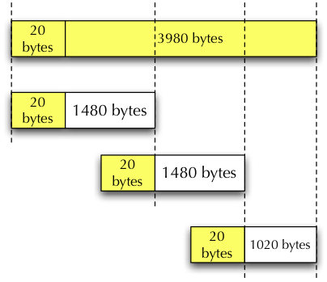
Fragmentation - Example
An IP datagram of size 4000 bytes arrives at a router
  The MTU of the link is 1500 bytes
  The IP header is 20 bytes long
  So the payload has to be fragmented and sent in new IP datagrams
Each IP datagram has the source and destination address
  The header of the payload protocol is NOT repeated
  This enables Oscar to play some tricks
This packet shows the
protocol that it carries

Slide 34
Fragmentation – Example (cont.)
Each IP header has a 16 bit identification field
  This identifies the datagram sent by the host and will be the same for all fragmented packets
  The fragment id is set to this identification value
The first IP fragment will contain the protocol header of the payload (e.g. TCP, ICMP etc.)
  It has offset = 0, length = 1480 bytes
  It also has the “more fragments” field set to 1
The second IP fragment simply contains the next 1480 bytes of payload data
  offset = 1480, length = 1480, more fragments = 1
The third IP fragment has 1020 bytes of data,
  more fragments = 0

Slide 35
Fragmentation and Packet Filters
The IP header of each fragment indicates the protocol of the payload (e.g. TCP, ICMP, etc.) but the filter often does not read the contents
  Many packet filters are stateless - they are asked to block packets to port number N from all hosts
  They let the fragments into the networks blocking only the first one
Many services set a Do not Fragment (DF) flag
  This is done to discover the smallest MTU along a route
  An ICMP error message reports that the IP datagram cannot be delivered because the MTU is smaller and reports this value
Malicious fragmentation has led to many attacks
  Now possible to block any fragmented packet

Slide 36
Fragmentation Attacks
A port scanner such as nmap
  It can be used to fragment TCP headers into many IP datagrams
  Filters may not recognize the port number and allow all fragments into the network
  Oscar can successfully scan for open ports and services
No final fragment
  Common for DoS attacks on routers that try to reassemble packets for broadcast over a link
Overlapping fragments
  Teardrop is a DoS attack that uses overlapping fragments to confuse the OS and crash it
  Ping of death crafts IP packets with MTU’s greater than 65535 causing a crash

Slide 37
Dynamic Packet Filtering
Idea
  Create rule sets on-the-fly and tear them down when completed
Example
  A host from the internal network - say 136.142.117.221:1091 connects to a telnet server 130.215.17.13:23 on the outside
  A new rule set would be created as follows
    Allow packets from host 130.215.17.13 port = 23 to host 136.142.117.221 port = 1091
  The dynamic packet filter will examine all packets to make sure that the SYN, SYNACK and ACK were completed
  When it observes the FIN packets, it tears down the rule set thereby disallowing further communication from 130.215.17.13
Can be a burden on routers in terms of performance

Slide 38
Stateful Firewalls
More advanced and secure than packet filters
  Also called Stateful Packet Inspection (SPI)
  Same as dynamic packet filtering in many cases
Firewall keeps track of all requests for information from the Intranet
  Scans the destination of an inbound packet to see if it matches the source of a previous outbound request
  This can generally examine multiple layers of the protocol stack
    Typically at layers 4 and below, but sometimes at the application layer as well
    Data can also be analyzed if required
    Blocking can be done at any layer or depth

Slide 39
Stateful Firewalls (cont.)
Stateful firewalls maintain “state” in a content table
  Allows them to accomplish a higher level of security than simple packet filters
  Still possible to fool them because some incoming connections are allowed without outgoing connections being created
Maintaining state information for UDP and ICMP is hard
  There is no concept of state for these protocols
  For UDP, the port numbers are important in maintaining some pseudo-state information
  Some ICMP messages can have pseudo-states (requests and responses) but one way ICMP traffic is harder to manage

Slide 40
Filtering vs. Inspection
Filters typically look at only layer 3 and some layer 4 information
  This is called packet filtering
It is possible to examine higher layer information, sequence numbers, and payload as well
  Example: the state of HTTP and FTP can be examined - The GET command can be examined or the port number exchange in FTP can be examined
  This is called stateful inspection
In stateful firewalls, application layer examination is minimal and abbreviated
  The entire protocol stack is NOT implemented and it is harder for the firewall to perform a thorough examination
  It can make the rules extremely complex

Slide 41
Proxy Firewalls or Gateways
Act as a relay for application/lower level traffic
  Client contacts the gateway with identification information
  The gateway contacts the application server and relays packets to and from it
  It acts on behalf of a client and shields either side from direct connection
Make two separate TCP connections
  One between the proxy and the outside host
  Another between the proxy and the inside host
The gateway can be made to support only certain services and protocols
  Example no Javascript in HTML pages

Slide 42
Proxy Firewalls (cont.)
Proxies are both clients and servers
  To the client connecting to it, a proxy behaves as a server
  To the server providing network services, it acts as a client
  To distinguish between the real client and server, often times we refer to the “listener” and “initiator” of the proxy
Proxies shield the protected system from being viewed by external systems
Proxies usually run on a dual homed host called a Bastion host
Proxy Firewall
Internet
Protected
Network
Dual Homed with IP
Forwarding Disabled

Slide 43
Bastion Host
Bastion = fortress
A Bastion Host is a system that serves as a platform for a proxy firewall
  It employs a secure version of the operating system
  Only required services are installed on it
    e.g. , you cannot have a new server installed
  No user accounts exist on the Bastion host
Proxy modules implement simplified versions of the software
  Easy to analyze code for loopholes
Services on Bastion Hosts
  Web, FTP, E-mail, DNS

Slide 44
Firewall Architectures
Placement of packet filters and gateways can impact the security
  Depending on the network layout and protocol Oscar could get some access, no access, etc.
Many types of architectures are possible
  Bastion host – “fortress” guards the rest of the private network
  Bastion host may be single or multi-homed
  Network segments may also be isolated (DMZ)

Slide 45
Firewall Configurations (1)
Bastion host
Or proxy firewall
Private
Packet Filter
Screened host firewall, single homed bastion
  Packet filter allows packets addressed only to or from the bastion host to pass through
  Two levels of security
  If the packet filter is compromised, so is the network

Slide 46
Firewall Configurations (2)
Bastion host
Or proxy firewall
Private
DMZ
Packet Filter
Screened host firewall, dual homed bastion
  Prevents breach of security when the packet filter is compromised
  More secure and prevents any direct physical connection between the private network and the outside world

Slide 47
More Complex Example
DMZ
GW
Packet Filter
Outside
Inside Net0
Inside Net1
Inside Net2
BH1
BH2
Gateway is in the DMZ
  Outside world can contact GW but in a limited way because of the packet filter
  Limited connections are possible between Net1 or Net2 and GW
  Anything can pass between Net1 and Net2
  Outgoing calls are possible from Net1/Net2 to the outside world
  What rules must be in place?

Slide 48
Firewall Configurations (3)
Bastion host
Or proxy firewall
Inside
Packet Filter
Private
DMZ
Outside Packet
Filter
Dial-up
Screened subnet firewall
  Two packet filters are used
  An isolated subnetwork containing the bastion host and other insecure connections is created
  There are three levels of defense and the private network is invisible to the rest of the world
  The rest of the world is invisible to the private network

Slide 49
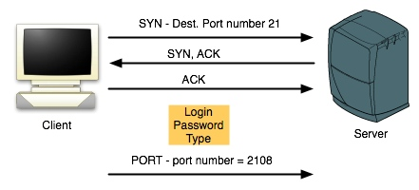
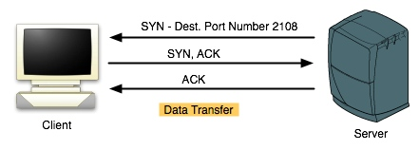
Example - FTP: PORT option
Operation
  The client (user) first opens a “control” channel to the server
  To set up the data connection, there are two options
PORT
  Client sends a PORT command in the control channel
  Contains IP address (perhaps different) and random port number of client
  FTP server connects from port 20 to the random port at client

Slide 50
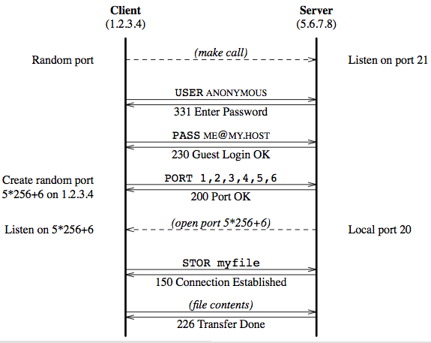
More Details of PORT

Slide 51
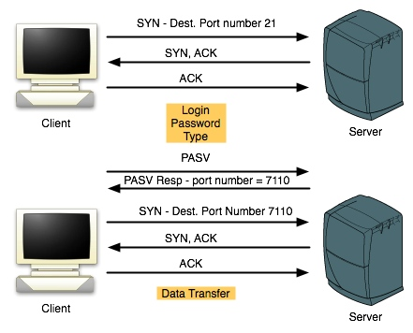
Example - FTP: PASV option
PASV - Passive option
  Client sends PASV
  Server starts listening on a random port and informs client in the response
  Client initiates the data channel
    Could be any new IP address and port number

Slide 52
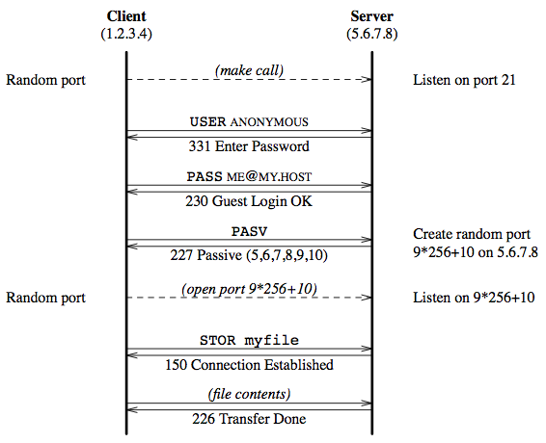
More Details of PASV

Slide 53
FTP Impact on Firewalls
Packet Filter
  If all incoming TCP connections (SYN) to random ports are disabled, FTP will not work with PORT, it will with PASV
  Similar impact with dynamic packet filters
Stateful Firewalls
  With deep packet inspection, may allow FTP to proceed
Proxy Firewalls
  Need to be aware of the two channels and behave appropriately to let FTP work

Slide 54
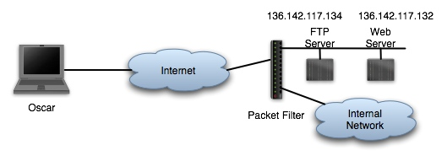
Potential attack using FTP
Screened
subnet
FTP server allows anonymous connections
Web server also runs Telnet for administrators
Stateful firewall blocks all inbound connections except those to port 21 on the FTP server and port 80 on the web server
  Appears that we are protected if the Telnet service has vulnerabilities

Slide 55
Potential attack using FTP (cont.)
What does Oscar do?
  Uses legitimate FTP connection to upload a file to the FTP server
  File contains exploit commands against Telnet
  Using the control channel, sets the IP address and port number for data transfer to 136.142.117.132 and 23
  Uses command channel and “RETR” command to retrieve the malicious file
  The malicious file is however sent to the web server at port 23!
Solution
  Allow uploads but not downloads
  Use a proxy firewall
    The proxy can determine that the IP address in the port command is an internal IP address and block the transfer

Slide 56
Types of Firewalls – Based on Device Types
Routers
  Most routers can be configured to act as packet filters
  Simple and fast, but usually not very secure
Multi-homed Hosts
  Run a software application on top of an OS
  Slower, but more secure
Single Hosts
  Most new OSs come with a built in software Firewall to protect a single host
Appliances
  Hardware, software and firmware particularly optimized for firewall functionality

Slide 57
Personal Firewalls
Also called “desktop firewalls” are becoming very popular
  Protect individual hosts from malicious packets
  Perform per host packet filtering
When we have network based firewalls, why do we need personal firewalls?
  Mobile users
  Connections that bypass the network firewall
  Layered defense
How it works?
  Checks to see if software is allowed to access the Internet
  Uses hash functions to ensure that malicious software has not renamed itself as a legitimate software
  Similar to egress filtering
  Some are complex, others more suitable for less tech-savvy users
Many products are available, sometimes bundled as “Internet Security” solutions
  Zone Alarm - http://www.zonelabs.com
  McAfee, Symantec, Sygate, Panda Software, etc.

Slide 58
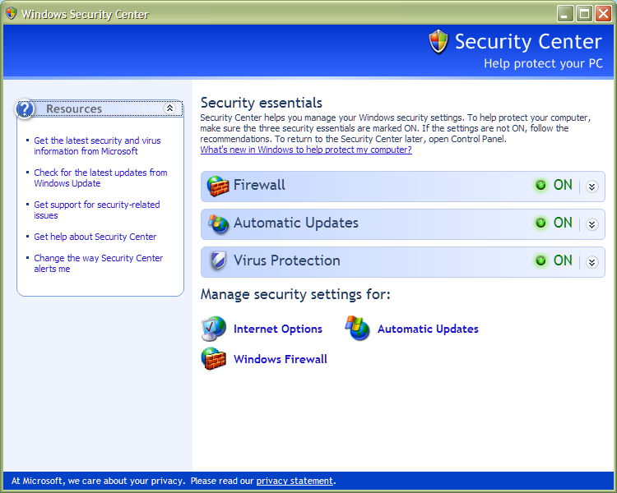
Windows Firewall
Windows XP SP2 comes with its own GUI and controls for the Windows Firewall

Slide 59
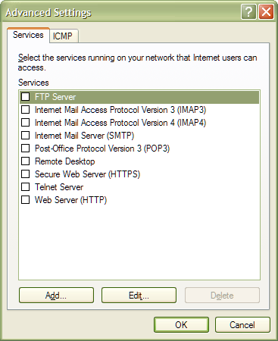
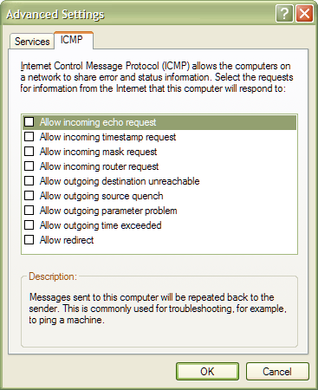
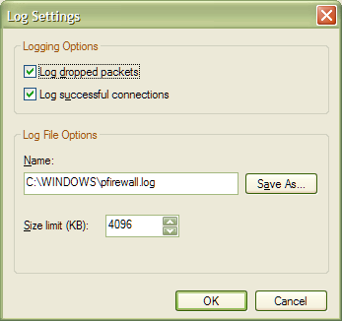
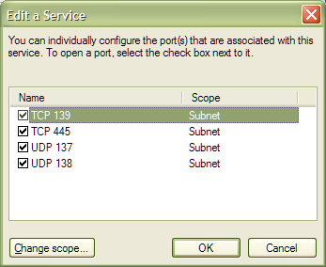
Windows Firewall (cont.)

Slide 60
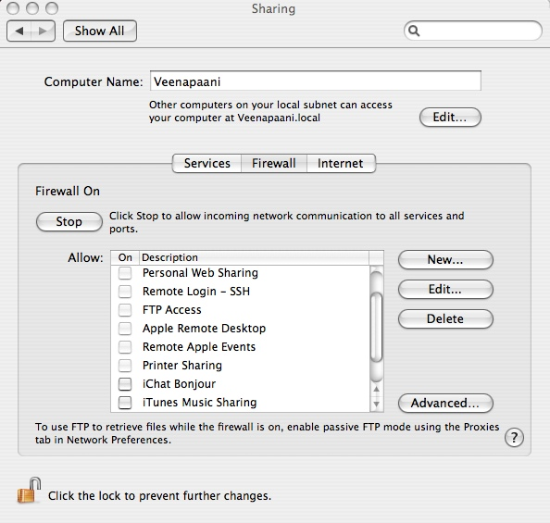
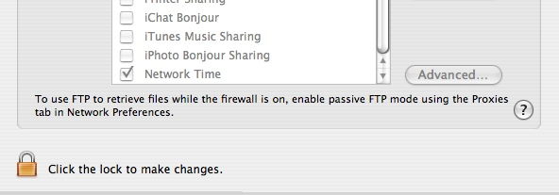
MacOS X Firewall

Slide 61
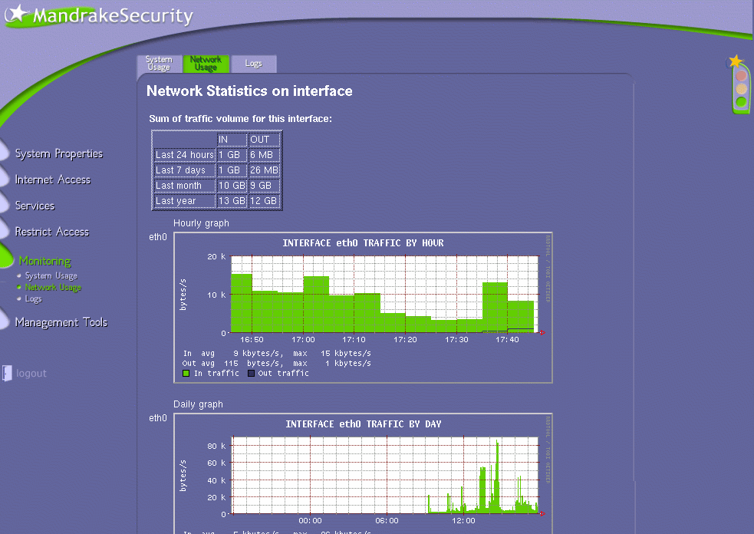
Network Statistics on a Mandrake (Personal firewall for Linux distributions)

Slide 62
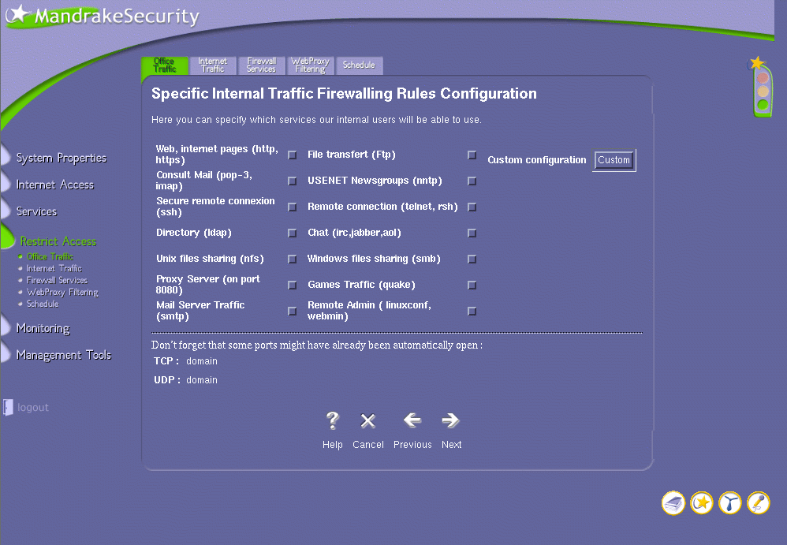
Firewall Rules

Slide 63
Packet Filtering – Cisco IOS
Cisco routers maintain an access control list (ACL)
  To configure a Cisco ACL, you have a command that looks like this
    access-list <number> <criteria>
      <number> is a label for the type of protocol (IP, IPX etc.)
  Can also use a named ACL that has the syntax
    ip access-list <type> <name>
    permit | deny <criteria>
  Can add logging of packets that are rejected
There are many types – standard, extended and reflexive ACLs
  Standard ACL blocks only source addresses for example
    Faster at the packet filter device
  Extended ACL looks at port numbers and destination addresses

Slide 64
Additional Firewall Functions: NAT and PAT
Network Address Translation (NAT)
Port Address Translation (PAT)
The process of modifying network address information in datagram (IP) packet headers while in transit across a traffic routing device for the purpose of remapping one IP address space into another
Edits source address (NAT) & ports in IP traffic (PAT)
  All network traffic leaving public side of the NAT appears to originate from one (or more) global IP address
192.168.0.2
NAT
157.55.0.1
Internet
192.168.0.3
192.168.0.1

Slide 65
NAT or PAT Advantages
Public IP Address Sharing
  A large number of hosts can share a small number of public IP addresses. This saves money and also conserves IP address space.
Easier Expansion
  Since local network devices are privately addressed and a public IP address isn't needed for each one, it is easy to add new clients to the local network.
Greater Local Control
  Administrators get all the benefits of control that come with a private network, but can still connect to the Internet.
Increased Security
  The NAT translation represents a level of indirection. Thus, it automatically creates a type of firewall between the organization's network and the public Internet. It is more difficult for any client devices to be accessed directly by someone malicious because the clients don't have publicly-known IP addresses.

Slide 66
Additional Firewall Functions: VPN
Firewall-to-Firewall Security
  Also called gateway-to-gateway security
Used to create a secure virtual private network (VPN) over a non-secure backbone network
Low cost way to connect remote users and networks together (e.g. sremote.pitt.edu)
Internet
Secure tunnel between
firewalls (forms VPN)
Encrypted tunnel
Firewall
Firewall
“secure”
network
“secure”
network
© Scott Midkiff

Slide 67
Firewall Vulnerabilities
Since port 80 is typically open, many users abuse it by tunneling other applications within HTTP using SOAP
  SOAP (Simple Object Access Protocol) is a protocol specification for exchanging structured information in the implementation of Web Services in computer networks
  Read http://www.schneier.com/crypto-gram-0006.html#SOAP
There are reports on vulnerabilities in commercial firewalls
  Checkpoint’s FireWall-1 product vulnerabilities reported in July 2000
  Cisco’s IOS has security vulnerabilities in some versions
    IOS is used in most Cisco products including packet filters and firewalls
    IOS source code was stolen and posted on the web allegedly by a 16 year old at Uppsala, Sweden in 2004
  Symantec’s Raptor firewall
    It was possible to hijack sessions passing through the firewall

